Slide 1
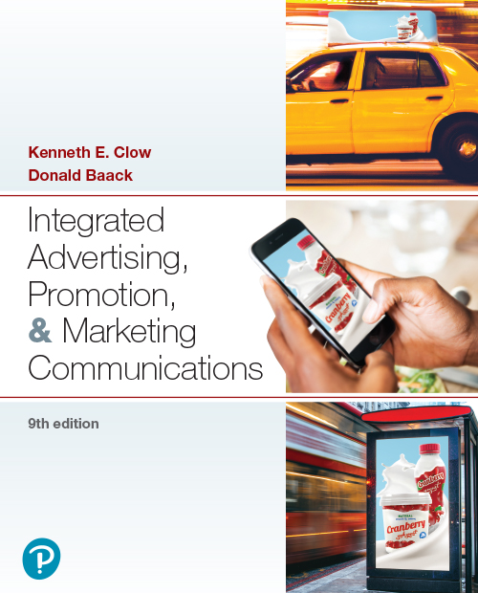

Integrated Advertising, Promotion, and Marketing Communications
Ninth Edition
Chapter 2
Brand Management
Copyright © 2022, 2018, 2016 Pearson Education, Inc. All Rights Reserved
Notes:
If this PowerPoint presentation contains mathematical equations, you may need to check that your computer has the following installed:
1) MathType Plugin
2) Math Player (free versions available)
3) NVDA Reader (free versions available)

Slide 2
Chapter Objectives (1 of 2)
2.1 How does a brand’s image affect consumers, other businesses, and the company itself?
2.2 What types of brands and brand names do companies use?
2.3 What characteristics do effective logos exhibit?
2.4 How do marketers identify, create, rejuvenate, or change a brand’s image?
Notes:
These are the objectives for Chapter 2.

Slide 3
Chapter Objectives (2 of 2)
2.5 How can a company develop, build, and sustain a brand in order to enhance brand equity and fend off perceptions of brand parity?
2.6 What current trends affect private brands?
2.7 How can packaging and labels support an I M C program domestically and in foreign settings?
2.8 How do firms manage brands in international markets?
Notes:
These are additional objectives for Chapter 2.

Slide 4
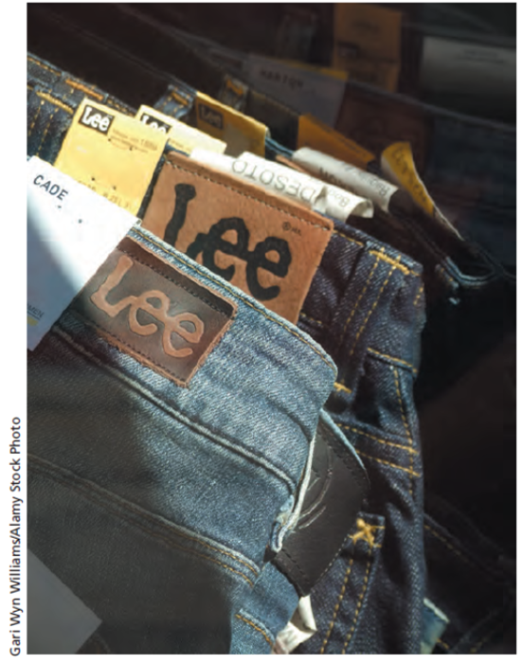
Chapter Overview
Managing a brand image and logo
Developing and promoting brands
Brand equity versus brand parity
Importance of packaging and labels
Notes:
The chapter begins with a discussion of brand – the word, term, or phrase featured as the name of a product, product line, or company. Managing an organization’s brand image constitutes a critical element in the successful maintenance of an integrated marketing communications plan. A corporation’s brand image reflects the feelings consumers and businesses hold regarding the overall organization as well as its individual products or product lines. Issues with developing and promoting brand names and logos are presented. Lastly, the chapter presents information about packaging and labeling. In addition to protecting products, packaging is a final marketing message to consumers to make a purchase decision.

Slide 5

Michelin
Created brand association with the Michelin Tire Man
Durability, reliability, safety key concepts for consumers
Michelin is also devoted to safe driving and tire care
Result: A stable company with consistent brand image
Notes:
What do you know about Michelin tires and the Michelin Man? What brand associations can you make with this brand? When consumers consistently connect a product’s name with a specific meaning, concept, or idea, the term brand association applies. The Michelin Tire company has held such a distinction over several decades. The firm’s success illustrates many of the principles regarding brand and image development described in this chapter.

Slide 6

A Brand Image Ad for Rev Select
Notes:
Part of an integrated marketing campaign is brand image advertising. This advertisement for Rev Select creates a new element for the company’s image that incorporates the digital age into modern farming.

Slide 7
Figure 2.1: Elements of Brand Image
Tangible Elements
Goods or services sold
Retail outlets where the product is sold
Advertising
Marketing communications
Name and logo
Packaging and labels
Employees
Intangible Elements
Corporate personnel
Ideals
Beliefs
Conduct
Environmental policies
Corporate culture
Country location
Media reports
Notes:
Brand image is made up of everything a company does, has, and is. It includes tangible and intangible elements. Tangible elements can be observed. In addition to the goods and services that are sold, tangible elements include the retail outlets where the products are sold and the factories where the products are made. Advertising, promotions, and other forms of communications all reflect the image of a brand. Certainly the brand name and logo convey a specific message. Packaging protects products, and labels provide information about the product inside. The last tangible element are the employees. What they say about a company influences consumers. On the intangible side are policies of the company in dealing with employees and other publics. Ideas and beliefs espoused by corporate personnel become part of the image. Even the culture and location of the company are important. Lastly, media reports can enhance or harm a company’s image depending on what is communicated.

Slide 8
Figure 2.2: Brand Image Benefits to Consumers
Provides confidence regarding purchase decisions
Gives assurance about the purchase when the buyer has little or no previous experience
Reduces search time in a purchase decision
Provides psychological reinforcement and social acceptance of the purchase

Slide 9
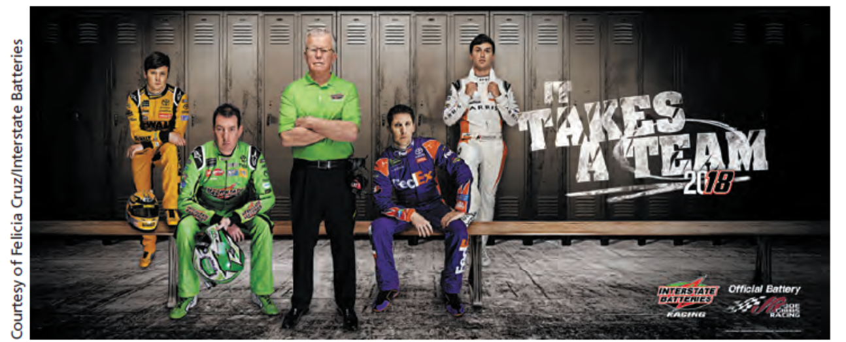
Interstate Batteries: A Strong Brand Image
Notes:
Interstate Batteries has accrued benefits from a strong corporate brand image. What brand images can you associate with this company?

Slide 10
Figure 2.3: Brand Image Benefits to Companies
Extension of positive customer feelings to new products
Ability to charge a higher price or fee
Consumer loyalty leading to more frequent purchases
Positive word-of-mouth endorsements
Higher level of channel power
Ability to attract quality employees
More favorable ratings by financial observers and analysts
Notes:
Having a strong brand image also benefits a company. It allows for the extension of new products. In most cases, the feelings and image that consumers have about the brand will transfer to the new product. Because of the strong image, a company can price its products higher. Customers are willing to pay the higher price and become more loyal as well. They also tend to purchase more frequently and often generate positive word-of-mouth communications. In terms of the distribution channel, a strong brand name allows a company to have greater channel power. Because consumers purchase the company’s products, retailers and other channel members will want to stock it. Even employees and potential employees are attracted to good companies. They want to be associated with the firm. Lastly, it provides more favorable ratings with investors.

Slide 11

Figure 2.4: Categories of Brand Names
Overt names
Implied names
Conceptual names
Iconoclastic names
Notes:
Choosing a brand name is important. Companies will spend thousands and even millions on choosing just the right name. Brand names can be divided into four categories:
Overt names reveal what a company does, such as American Airlines.
Implied names contain words or word parts that convey what a company does, such as FedEx.
Conceptual names capture the essence of what a company offers, such as Twitter.
Iconoclastic names represent something unique, different, and memorable. The name does not reflect or imply what the company does. Nike would be an example.
In the ad shown, Craig General Hospital would be an example of an overt name. It is evident that the organization provides health care.

Slide 12
Questions to Consider (1 of 3)
Can you think of corporate brand names that fall into each of the categories in Figure 2.4?
Which ones are your favorites and why?
Why would you choose these brands over competitors?

Slide 13
Figure 2.5: Origins of Some Unique Brand Names
Google–name started as a joke about the way search engines search for information. Word googol is one followed by 100 zeros.
Lego–combination of Danish phrase “leg godt,” which means “play well” and Latin word lego which means “I put together.”
Reebok–alternative spelling of “rhebok,” which is an African antelope
Skype–original name was “sky-peer-to-peer,” which was changed to “skyper,” then to “skype.”
Verizon–combination of Lain word “veritas” which means “truth” and “horizon.”
Volkswagen–created by Adolf Hitler as a car for the masses that could transport 2 adults and 3 children at speeds up to 62 mph. Name means “people’s car.”
Yahoo–word from Jonathan Swift’s book Gulliver’s Travels, which represented a repulsive, filthy creature that resembled a Neanderthal man. Yahoo! founders, Jerry Yang and David Filo considered themselves to be yahoos.
Notes:
Brand names should meet four tests. First, they should be easily recognizable. Second, they should be names and symbols that are familiar to people. Third, the meaning should be consensual, i.e. everyone who sees the logo or hears the name has similar thoughts and ideas. This process of having shared meanings across consumers is called stimulus codeability. This helps especially in global markets, but is difficult to achieve across national boundaries. Fourth, brand names should evoke positive feelings.

Slide 14
Figure 2.6: Types of Brands
Family brands
Brand extension
Flanker brand
Co-branding
Ingredient branding
Cooperative branding
Complementary branding
Private brands
Notes:
Here, we can see several types of brands and branding. The substantial impact branding has on purchase behaviors means that marketers should make branding decisions thoughtfully.

Slide 15
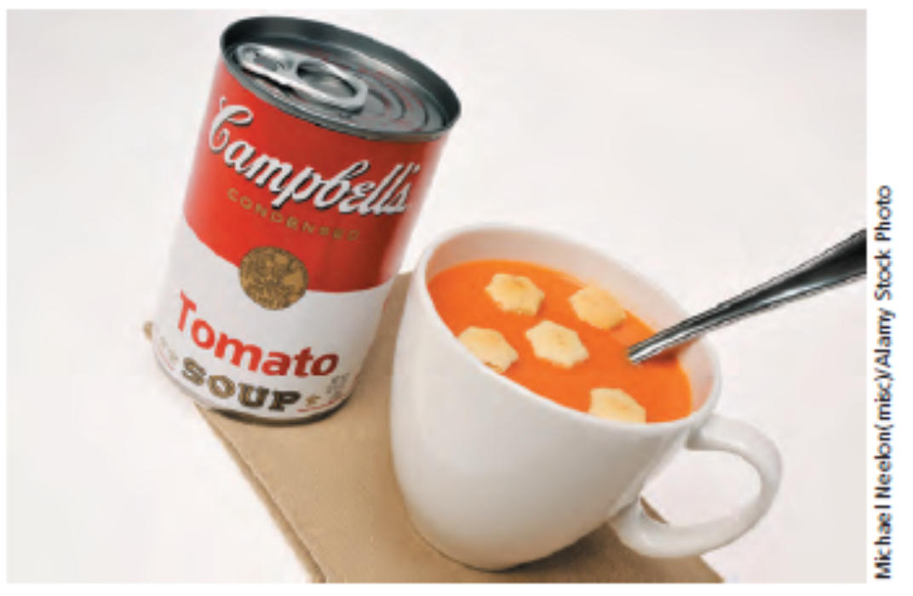
Campbell’s: Family Brands
Notes:
Campbell’s strong brand name enables the company to apply it to a variety of soups and vegetable products. Can you think of any of these?

Slide 16
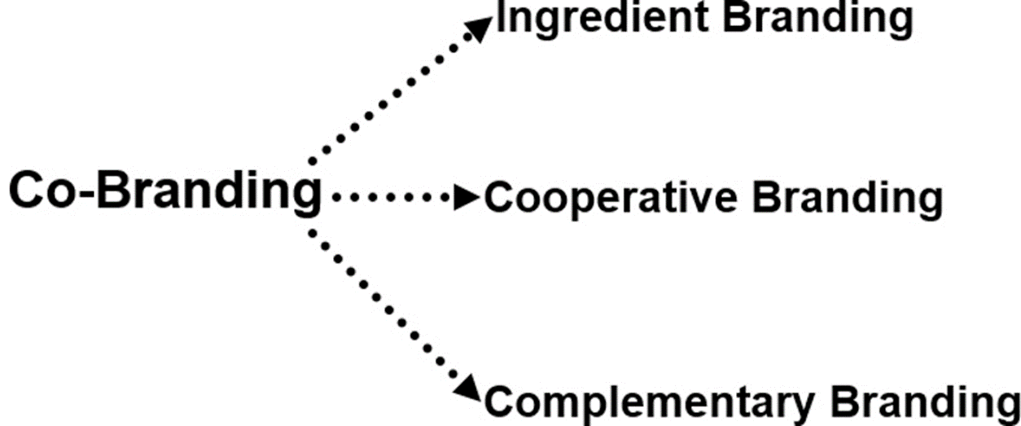
Figure 2.7: Forms of Co-Branding
Notes:
Co-branding or alliance branding is the offering of two or more brands in a single marketing offer. There are three types of co-branding options. Ingredient branding is the placement of one brand within another brand, such as Intel processors in various brands of computers. Cooperative branding is the joint venture of two or more brands into a new product or service, such as VISA card offered by JP Morgan Chase with American Airlines. Complementary branding is the marketing of two brands together for co-consumption, such as Oreo milkshakes at Dairy Queen.

Slide 17
Figure 2.8: Four Tests of Quality Brand Logos and Names
Recognizable
Familiar
Elicits a consensual meaning among those in the firm’s target market
Evokes positive feelings
Notes:
Quality logos and brand names should meet four tests. First, they should be easily recognizable. Second, they should be names and symbols that are familiar to people. Third, the meaning should be consensual, i.e. everyone who sees the logo or hears the name has similar thoughts and ideas. This process of having shared meanings across consumers is called stimulus codeability. This helps especially in global markets, but is difficult to achieve across national boundaries. Fourth, the logo and name should evoke positive feelings.

Slide 18
Figure 2.9: Some of the Oldest Logos
Company/Brand | Year Company Founded | Year Logo First Used
John Deere | 1837 | 1876
Coca-Cola | 1886 | 1886
Johnson & Johnson | 1886 | 1886
Union Pacific Railroad | 1862 | 1888
Prudential Life Insurance | 1875 | 1896
Campbell’s Soup | 1869 | 1898
General Electric | 1892 | 1900
Goodyear | 1898 | 1901
Sherwin-Williams | 1866 | 1905
DuPont | 1802 | 1907
Notes:
This list contains some of the oldest brand logos. How many of these brands can you recognize?

Slide 19
Brand Logos
Aid in recall of specific brands
Aid in recall of advertisements
Reduce shopping effort
Reduce search time and evaluation of alternatives
Notes:
Corporate logos are important because often people see the logo and instantly know the company. In a symbolic way, it conveys a message. Corporate logos provide several benefits. They aid in recalling specific brands and advertisements. People may not notice the brand name, but the logo is a picture and tends to be remembered better. In shopping, customers often look for familiar logos and colors of packages and products, which saves time and energy. They don’t need to look at alternatives.

Slide 20
Figure 2.10: Tips on Creating or Changing Logos
The logo is a reflection of the brand
Creating logos requires knowledge and expertise
Use professional designers
Make the logo simple
Make the logo media transferrable
Notes:
Creating or changing logos takes careful consideration. It requires knowledge and expertise in logo design and an understanding that the logo is a reflection of the brand. It is best to use professional designers. The temptation is for a business owner to do it himself using a graphics design package. Logos should be simple. They also should be transferrable across multiple mediums.

Slide 21

Identifying the Desired Brand Image
Evaluate current image
Ask customers
Ask non-customers
Can be a strategic advantage
Notes:
The first step in managing a brand image is to identify the desired image. This begins with evaluating the current image by asking customers what they think. It is also important to ask non-customers. They often present a different view, one that reflects why they did not make a purchase. As shown here, creating the right brand image for Arvest Bank begins with identifying its current image.

Slide 22

Creating the Right Image
Sends a clear message
Portrays what the firm sells
Business-to-business may be challenging
Notes:
Creating the right image is important. It sends a clear message about what the firm sells and what it stands for. With the business-to-business sector, creating the right image may be more challenging. This advertisement for Asbell highlights the primary services the company provides.

Slide 23
Rejuvenating a Brand’s Image
Sells new products
Attracts new customers
Retains current customers
Key – remain consistent with old and new
Takes time and effort
Notes:
In some cases an image has become stale or not quite in sync with what the company wants. It is then time to rejuvenate the image. The company wants to keep what is good about the past but build new concepts for the future or modify the view slightly to be more relevant to consumers. Rejuvenating a brand image can produce a number of positive results, such as increasing sales, attracting new customers, and retaining current customers. The key to rejuvenating an image successfully is to remain consistent with the old image while adding new elements. It takes time and effort and will not happen overnight.

Slide 24
Figure 2.11: Keys to Successful Image Rejuvenation
Help former customers rediscover the brand
Offer timeless consumer value
Stay true to original, but contemporize
Build a community
Notes:
Successful rejuvenation of a brand requires 4 critical ingredients – helping former customers to rediscover the brand, offering timeless consumer value, staying true to the original, yet contemporizing the brand, and building a community of loyal consumers. Rejuvenation requires retaining current customers, winning back former customers, and attracting new customers. The opening vignette about Applebee’s is a good illustration of rejuvenation.

Slide 25
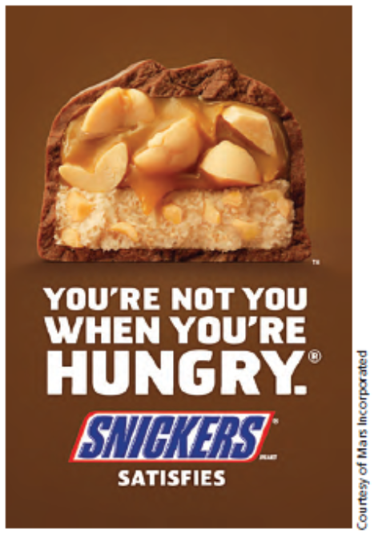
Changing a Brand’s Image
Extremely difficult
Necessary when target market declines or brand image no longer matches industry trends
Requires more than advertising
Begins internally, then moves outward
Notes:
The most difficult challenge is changing an image. At times, it may not even be possible. It becomes necessary to change an image when the target market declines, resulting in lower sales or when the product no longer matches industry trends. Changing an image requires considerably more advertising. It has to begin internally, and then move outward. Employees must see the change, believe the change has occurred, and then convey that change to every contact the company makes. This Snickers print ad reinforces television commercials suggesting the candy helps a person maintain an “edge.”

Slide 26
Questions to Consider (2 of 3)
Can you think of companies that have rejuvenated their brands by following the principles in Figure 2.11?
What was the result?
How about instances in which companies tried to completely change the brand’s image?
Was it successful? What do you think would be most difficult about this process?

Slide 27
Developing and Building Powerful Brands
Understand why consumers buy and rebuy a brand
Where does your brand stand now?
What are your objectives?
What are you doing to build your brand and business?
What are your brand’s strengths? Weaknesses?
Which opportunities should be pursued first?
Where are the pitfalls?
Notes:
Developing strong brands begins by understanding why consumers buy and rebuy a brand. Here are some typical questions one can ask a client to measure the current position of a brand and to help an agency understand the current position of a brand.

Slide 28
Figure 2.12: Building Powerful Brands (1 of 2)
Invest in the brand
Create awareness
Offer authenticity uniqueness
Build trust
Deliver an experience
Offer value
Utilize social media
Utilize mobile
Act responsibly

Slide 29
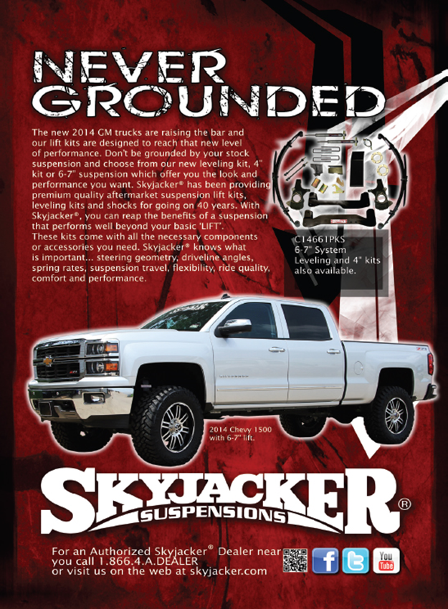
Figure 2.12: Building Powerful Brands (2 of 2)
Skyjacker has built a powerful brand by providing customers with a good experience and delivering value.
Notes:
Skyjacker dominates the vehicle suspension market and has built a powerful brand by delivering value and a positive customer experience. Visit Skyjacker’s website on https://skyjacker.com/.

Slide 30
Brand Loyalty
The ultimate objective
The only brand that customers purchase
Drivers of brand loyalty:
Emotion
Value
It’s all about the consumer experience
Notes:
Brand loyalty is the ultimate goal of building powerful brands. With brand loyalty, consumers purchase only that specific brand regardless of the effort necessary. They are not willing to substitute another brand. Drivers of brand loyalty are an emotional connection and value. Brand loyalty goes beyond functional attributes. Can you think of some brands to which you are especially loyal? What drives that loyalty?

Slide 31
Brand Equity
Brand parity can be a problem
Brand equity
A set of characteristics making the brand unique
Helps fight the brand parity problem
Brand name is perceived as better
Notes:
Brand parity is when consumers see very few differences among brands. Brand equity is a set of characteristics that makes a brand unique. Brand equity helps fight brand parity situations because the brand is perceived as being better.

Slide 32
Private Brands
Popularity has fluctuated
Connotation of low price, inferior quality
Historically catered to price-sensitive consumers
Retailers invest in private brands
Many consumers see few differences
Notes:
The popularity of private brands has fluctuated over the years. In the past, private labels were seen as low priced, low quality goods. Historically, only price-sensitive consumers purchased private brands. Because of the higher gross margins on private brands, retailers began investing into their private brands. As a result, two-thirds of consumers today see private brands as being equivalent to manufacturers’ brands.

Slide 33
Figure 2.13: Changes in Private Brands
Improved quality
Perceived as a value purchase
Higher loyalty toward retail outlets and lower loyalty toward specific brands
Used to differentiate retail outlets
Increased advertising of private brands
Increased quality of in-store displays and packaging of private brands
Notes:
Private brands (labels) have changed in a number of ways. The quality of private labels has improved. In fact, most consumers believe the quality of private labels is now equivalent to brand labels. In most cases, the price of private labels is below manufacturers’ brands, which consumers see as a value purchase. With the rise of large retail store chains, consumers have become more loyal to retail stores and less loyal to specific brands. For example, a consumer may say “whatever brands are sold by Dillard’s (or another retail store) is okay because that is where I want to shop.” Retailers are now using private labels to differentiate themselves from other retail outlets. In addition to improving quality, retailers have invested more money in advertising private labels, improving in-store displays of private labels, and improving the packaging of private labels. The result is that now many consumers cannot tell the difference between a retailer’s own private labels and a manufacturer’s label.

Slide 34
Advantages to Retailers
Private Labels
Higher gross margins
Lower prices
Greater loyalty to stores and brands within a store
Differentiates stores from national brands
Many consumers are unaware of the difference
Notes:
Private labels are attractive to retail stores for a number of reasons. Because the retailer owns the private label, the gross margins earned per product are higher than on manufacturers’ labels. This means the retailer can lower the price of the private label and still make more money. It also makes the private label attractive to customers. With increased brand parity, consumers have become more loyal to stores and less loyal to national brands, which benefits the retailer and private labels. For instance, JC Penney offers more than 30 private label apparel lines, which accounts for 40% of sales in the apparel category. Because of the benefits of private labels, retailers are investing more dollars into advertising and marketing. Often the ads do not tell consumers it is a private brand. In many cases, consumers do not know which brand is owned by the retailer (a private brand) and which one is owned by a manufacturer (national brand).

Slide 35
Figure 2.14: Tactics Used by Manufacturers to Combat Retail Private Brands
Focus on core brands
Increase advertising
Introduce new products
Focus on in-store selling, packaging
Use alternative methods of marketing
Notes:
Because of the rise in popularity and sales of private brands, manufacturers have been forced to look at strategies to fight back. Some manufacturers have chosen to focus on core brands. They may or may not drop some of their other brands, but the focus is on the core brands. For these brands, advertising budgets are increased. Innovation and new products are introduced sooner and more often. There is a greater focus on in-store selling and packaging. Rather than focus only on traditional media, alternative methods of marketing are pursued.

Slide 36
Packaging
Final opportunity to make impression
Two-thirds of purchase decisions made in-store
Have three seconds to catch attention
Package must stand out
Must tell customers what is inside
Notes:
The importance of packaging should never be overlooked. It is the final opportunity to make an impression. Research has shown that two-thirds of purchase decisions are made in the store. This means packaging can be influential in the final purchase decision. Research has further shown that a package has three seconds to catch someone’s attention. Therefore, it needs to stand out. It needs to tell customers what is inside, or why they should look inside.

Slide 37
Figure 2.15: Primary Purposes of Packaging
Protect product
Provide for ease of shipping and handling
Provide for easy placement on shelves
Prevent or reduce theft
Prevent tampering (drugs and food)
Meet consumer needs for speed, convenience, and portability
Communicate marketing message
Notes:
A primary purpose of packaging is to protect the product. It also should provide for easy shipping, moving, and handling of the product from the manufacturer to the retailer. It should provide for easy placement on store shelves. For many products, the package should prevent or reduce theft and tampering. Packaging must meet consumer needs for speed, convenience, and portability. Lastly, packaging should communicate a marketing message that resonates with buyers and is integrated with the marketing of the product, thus everything involving the brand from advertising to packaging is speaking with one voice.

Slide 38

Labels
Must meet legal requirements
Provide another marketing opportunity
Typically contain logo and brand name
Q R codes can link to social media sites
Notes:
Labels are an important component of packaging. They must meet legal requirements in terms of listing contents and providing information on ingredients. But, labels also provide a marketing opportunity. Words such as gourmet, all-natural, and premium are used to convey what is offered and why it is important to consumers. Labeling can be the last opportunity to tell consumers about a product.

Slide 39
Ethical Issues in Brand Management
Brand infringement
Brand name can become a generic term
Cybersquatting
Notes:
Marketers can face some ethical issues in the area of brand management. First, brand infringement occurs when a company takes a brand name that is very similar to a current, successful, and popular brand. Victor’s Secret was a brand infringement on the brand Victoria’s Secret. Second, sometimes brand names become the generic term for the product category, such as Xerox and band-aids. More recently, the term Google has gained generic status. The last ethical issue is domain or cyber squatting, which is the purchase of website domains that individuals know are or will be valuable to a business or person. The reason for purchasing the domain is to be able to sell it for a high price later.

Slide 40
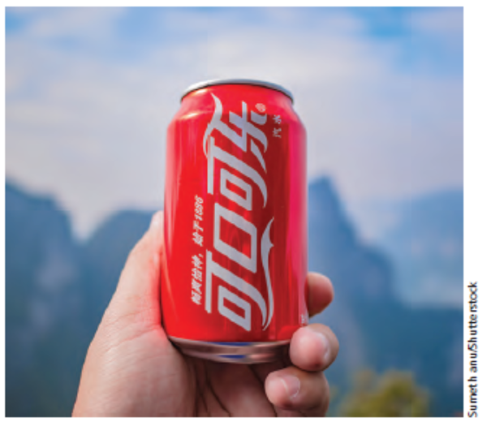
International Implications
Adaptation versus standardization
Standardization reduces costs
Shrinking world leads to standardization
Think globally, but act locally
Notes:
For global firms, brand management is an important issue. A major decision that has to be made is should the brand use a standardization approach to marketing or adaptation? Standardization is cheaper because the same brand name is used in multiple countries, and the same marketing plan is followed. With a shrinking world due to advances in information technology, standardization makes sense. Most people have access to media and communication from around the world and are exposed to people from around the world. All of this leads to standardization becoming more attractive.

Slide 41
Questions to Consider (3 of 3)
Think about the G I M C strategy to “Think globally, but act locally.”
How does this approach apply to branding?
Why is it important to consider each local market’s unique features?
How can it help to support and develop local brands?
Notes:
GIMC stands for global integrated marketing communications.

Slide 42
Your Career: A Personal Brand
You have unique characteristics, personality, image
What is your personal brand image?
Personal appearance conveys a lot to an employer
Consider mannerisms: speaking, gestures, eye contact, posture
Social media is key to your personal brand
Notes:
The image you project to current and future employers is especially important. Is that image correct? If not, then now is the time to develop a plan to change it. In addition, future entrepreneurs should pay special attention to the concepts in this chapter. A successful new company requires a strong brand that consumers recognize, recall, and respect.

Slide 43
Blog Exercises
Tesla
Nice Versus Kind
Interesting Logos
Notes:
The blog exercises for Chapter 2 include Tesla, Nice Versus Kind, and Interesting Logos. Links are embedded in the text for each.

Slide 44

Copyright
This work is protected by United States copyright laws and is provided solely for the use of instructors in teaching their courses and assessing student learning. Dissemination or sale of any part of this work (including on the World Wide Web) will destroy the integrity of the work and is not permitted. The work and materials from it should never be made available to students except by instructors using the accompanying text in their classes. All recipients of this work are expected to abide by these restrictions and to honor the intended pedagogical purposes and the needs of other instructors who rely on these materials.

